Slide 1
SQL 自学汇报（第一周）
汇报人：康珣

Slide 2
1
参考资源
目录
知识难点理解
2
3
题目分析
4
题目疑难
5
学习收获
Sql自学报告
康珣

Slide 3
参考链接
1
1、W3school 学习基本Sql操作
2、《SQL必知必会》
3、《SQL解惑》
Sql自学报告
康珣

Slide 4
知识难点理解
2
SELECT vend_id, COUNT(*) AS num_prods
FROM Products
WHERE prod_price >= 4
GROUP BY vend_id
HAVING COUNT(*) >= 2;
Group By按列名分组，该列中记录相同为一组
Having 数据分组后过滤，分组条件
Where 分组前过滤，适用所有行
1.Where先过滤出价格至少为4的行
2.Group By根据供应商id分组
3.Having过滤出id的对应计数大于2的行
（一个供应商有多个产品）
Count(*)计算所有非空行的数目
Count(列名)计算列有值的数目
Sql自学报告
康珣

Slide 5
子查询
SELECT cust_id, cust_name, cust_contact
FROM Customers
WHERE cust_name = (SELECT cust_name
FROM Customers
WHERE cust_contact = 'Jim Jones');
嵌套在其他查询中的查询。
例：Customers表中每个顾客的订单总数。订单与相应的顾客ID存储在Orders表中。
SELECT cust_name,cust_state,
(SELECT COUNT(*)FROM Orders
WHERE Orders.cust_id = Customers.cust_id) AS orders
FROM Customers
ORDER BY cust_name;
SELECT c1.cust_id, c1.cust_name, c1.cust_contact
FROM Customers AS c1, Customers AS c2
WHERE c1.cust_name = c2.cust_name
AND c2.cust_contact = 'Jim Jones';
内联结
Sql自学报告
康珣

Slide 6
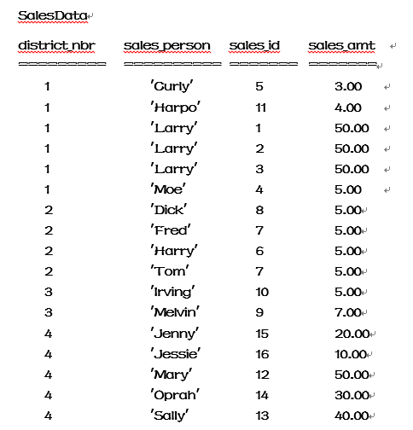
题目分析
3
Q1:top three sales_amt in their districts？
Salesdata表自联结。
1区：5*5行
每一个大于Curly的计数
Count <= 3
(不小于Curly的数有3个，前三)
S1.sales_amt <= S2.sales.amt
Q2:top three salesperson in their districts？
1.销售额 2.名字
思路同1，count计数时distinct取消相同销售额。选出sales_person取消相同名字
Sql自学报告
康珣

Slide 7
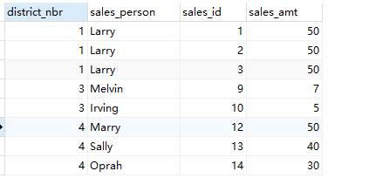
Q1:top three sales_amt in their districts？
select distinct * from salesdata as S1
where (select count(*) from salesdata as S2
where S1.district_nbr = S2.district_nbr
AND S1.sales_amt <= S2.sales_amt) <= 3
Order By S1.sales_id,sales_amt DESC;
Sql自学报告
康珣

Slide 8
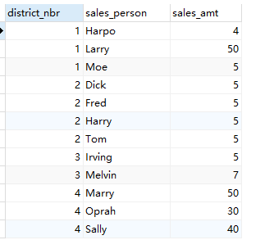
Q2:top three salesperson in their districts？
select distinct
S1.district_nbr,S1.sales_person,S1.sales_amt from salesdata as S1
where (select count(distinct S2.sales_amt) from salesdata as S2
where S1.district_nbr = S2.district_nbr
AND S1.sales_amt <= S2.sales_amt) <= 3
Sql自学报告
康珣

Slide 9
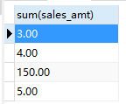
题目疑难
4
Q2:top three salesperson in their districts？
SELECT DISTINCT district_nbr, sales_person
FROM SalesData AS S0
WHERE sales_amt <= ( SELECT MAX(S1.sales_amt)
FROM SalesData AS S1
WHERE S0.district_nbr = S1.district_nbr
AND S0.sales_amt <= S1.sales_amt
HAVING COUNT(DISTINCT S0.sales_amt) <= 3);
人前三名
定义
Larry是1个人还是3个人？
是否SUM？
select sum(sales_amt) from salesdata where district_nbr = 1 GROUP BY sales_person
Sql自学报告
康珣

Slide 10
学习收获
5
熟悉概念
联结重要
不会可以学
可以多看点书
Sql自学报告
康珣

